Slide 1


CS 6831 Designing Secure Cryptography
Tom Ristenpart

Slide 2
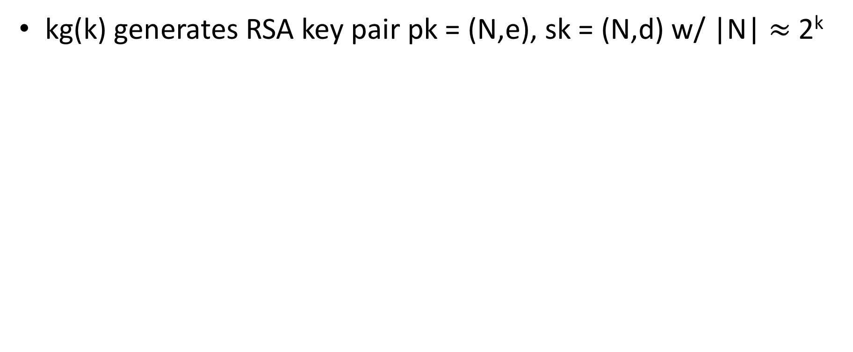
A simple scheme from RSA
kg(k) generates RSA key pair pk = (N,e), sk = (N,d) w/ |N| $≈$ 2^{k}
Hash function with suitable msg space
One-time secure SE scheme
kg_{s} outputs random n-bit string

Slide 3
IND-CPA for PKE
Left-or-right indistinguishability notion is traditional CPA security goal
Sufficient to consider adversaries that make a single query to Enc

Slide 4

TLS handshake for RSA transport
Client
Server
ClientHello, MaxVer, Nc, Ciphers/CompMethods
Pick random Nc
ServerHello, Ver, Ns, SessionID, Cipher/CompMethod
Pick random Ns
Check CERT
using CA public
verification key
CERT = (pk of bank, signature over it)
C
Pick random PMS
C <- E(pk,PMS)
PMS <- D(sk,C)
CPA security insufficient for security!
Server responds differently in cases that C decrypts to valid PMS, or not

Slide 5



A simpler example: QQ Browser
QQ browser popular in China, 100s millions of users
1024-bit RSA key (N,e),(N,d). Choose 128-bit AES key K at random. Message M
C = K^{e} mod N C’ = ECB(K,M)
QQ servers
C , C’
OK
X = C^{d} mod N
K’ = Low128bits(X)
If D(K’,C’) valid message then Ret OK
Ret FAIL
https://citizenlab.ca/2016/03/privacy-security-issues-qq-browser/
https://arxiv.org/pdf/1802.03367.pdf

Slide 6
A simpler example: QQ Browser
C = K^{e} mod N C’ = ECB(K,M)
C1 , C1’
OK
X = C^{d} mod N
K’ = Low128bits(X)
If D(K’,C’) valid message then Ret OK
Ret FAIL
C1 = 2^{127e} C mod N
C1’ = ECB(10¹²⁷,M)
C2 , C2’
FAIL
First bit of K is 1 if return OK
First bit of K is 0 if return FAIL
C2 = 2^{126e} C mod N
C2’ = ECB(110¹²⁶,M)
…
K = 10…
Recover full key in 128 queries
…
https://citizenlab.ca/2016/03/privacy-security-issues-qq-browser/
https://arxiv.org/pdf/1802.03367.pdf

Slide 7
A simpler example: QQ Browser
So many problems!
Earlier version: used RSA with 128 bit modulus
245406417573740884710047745869965023463
Used ms-precision timestamp as randomness source to generate K
Responses to requests actually didn’t use K, used hard-coded key K*
https://citizenlab.ca/2016/03/privacy-security-issues-qq-browser/

Slide 8
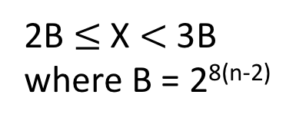
PKCS #1 RSA encryption
kg outputs (N,e),(N,d) where |N|₈ = n
Want to encrypt messages of length |M|₈ = m
(N,e)
Enc((N,e), M)
pad = n - m - 3 random non-zero bytes
X = 00 || 02 || pad || 00 || M
Return Xe mod N
Enc
2B $≤$ X $<$ 3B
where B = 2^{8(n-2)}
M
C
(N,d)
Dec((N,d), C )
X = C^{d} mod N ; aa||bb||w = X
If (aa ≠ 00) or (bb ≠ 02) or (00 w)
Return error
pad || 00 || M = w
Return M
Dec
M or
error
C

Slide 9
Bleichenbacher attack
Given ciphertext C, learn X = C^{d} mod N
C₁
OK
Dec((N,d), C )
X = C^{d} mod N ; aa||bb||w = X
If (aa ≠ 00) or (bb ≠ 02) or (00 w)
Return FAIL
pad || 00 || M = w
Return OK
C₁ = C s1e mod N
Response OK:
X*s1 mod N is in range [2B,3B)
or
X*s1 – rN in range [2B,3B) for some r

Slide 10
Bleichenbacher attack
Given ciphertext C, learn X = C^{d} mod N
C₁
padding error?
Dec((N,d), C )
X = C^{d} mod N ; aa||bb||w = X
If (aa ≠ 00) or (bb ≠ 02) or (00 w)
Return FAIL
pad || 00 || M = w
Return OK
C₁ = C s1e mod N
C₂
C₁ = C s2e mod N
…
padding error?
…
We can take a target C and decrypt it using
a sequence of chosen ciphertexts C₁, … , C_{q}
where q ≈ 1 million
[Bardou et al. 2012] q = 9400 ciphertexts on average

Slide 11
Response to this attack
Ad-hoc fix: Don’t leak whether padding was wrong or not
This is harder than it looks (timing attacks, control-flow side channel attacks, etc.)
Better:
use encryption against chosen-ciphertext attacks

Slide 12
Adapt symmetric CCA security notion?
Recall symmetric encryption ROR-CCA definition:

Slide 13
Adapt symmetric CCA security notion?
Can any PKE scheme achieve this LOR-CCA security?
Symmetric CCA:
can’t even generate valid ctxt
Asymmetric CCA:
can’t learn anything about challenge via decryptions

Slide 14
IND-CCA security
Add decryption oracle
Restrict from querying on challenge ciphertexts
Can consider only single Enc query

Slide 15
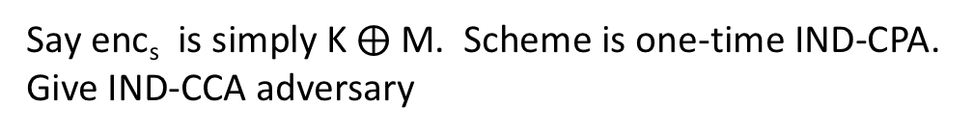
IND-CCA security
Say enc_{s} is simply K $⨁$ M. Scheme is one-time IND-CPA.
Give IND-CCA adversary

Slide 16
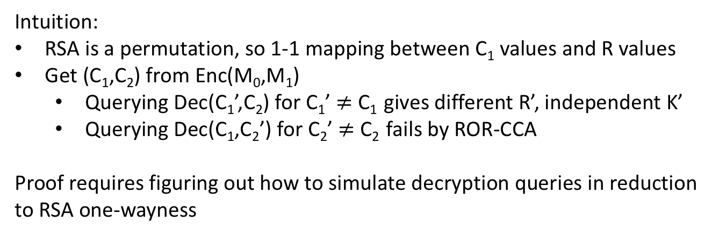
IND-CCA security
Say enc_{s} is ROR-CCA secure. Is PKE scheme IND-CCA?
Intuition:
RSA is a permutation, so 1-1 mapping between C₁ values and R values
Get (C₁,C₂) from Enc(M₀,M₁)
Querying Dec(C₁’,C₂) for C₁’ $≠$ C₁ gives different R’, independent K’
Querying Dec(C₁,C₂’) for C₂’ $≠$ C₂ fails by ROR-CCA
Proof requires figuring out how to simulate decryption queries in reduction to RSA one-wayness

Slide 18
From the IND-CPA proof of this scheme

Slide 19
Proof sketch:
Can use RO to help simulate decryption queries
Dec(C₁,C₂) check if any prev RO query on R is s.t. C₁ = R^{e} mod N
If so, use previous H(R) to decrypt C₂
Otherwise, choose random K to decrypt C₂
Add K to a table TabK[C₁] = K
Subsequent RO queries check if TabK[R^{e} mod N] set, if so return it
This properly simulates environment of adversary A, never uses secret key d

Slide 20
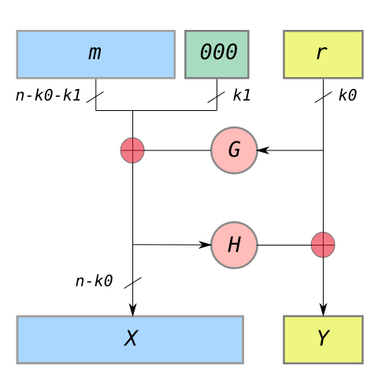
RSA-OAEP (optimal asymmetric encryption padding)
Provide better padding scheme than PKCS#1v1.5
OAEP is such a padding scheme
G,H modeled as random oracles
C = (X||Y)^{e} mod N
RSA one-wayness implies IND-CCA
Initial analysis had a gap
Later filled using specific properties of RSA
Variants exist with tighter reductions

Slide 21
El Gamal CCA Security
kg chooses random x from Z_{|G|}
pk = X = g^{x} sk = x
G is cyclic group with generator g
Is this CCA secure?

Slide 22
El Gamal CCA Security
kg chooses random x from Z_{|G|}
pk = X = g^{x} sk = x
G is cyclic group with generator g
Is this CCA secure?
Need stronger assumption than just CDH

Slide 23
Interactive CDH assumption
Solve CDH given also an oracle that solves DDH for related DH tuples of a certain form
Also (originally) called Strong DH assumption
No known attack better than solving CDH
DHCheck oracle allows simulating Dec queries of an IND-CCA adversary, thereby allowing reduction

Slide 24
Summary
Practical applications of PKE requires security against CCAs
Example of key transport schemes
RSA and SE hybrid scheme achieves this in ROM, assuming SE is itself CCA secure
OAEP is a specialized RSA scheme widely used
El Gamal and SE hybrid is CCA secure under stronger CDH assumption

